Slide 1
Big Data - Lecture 2
Creativity / Projects / Agile

Slide 2
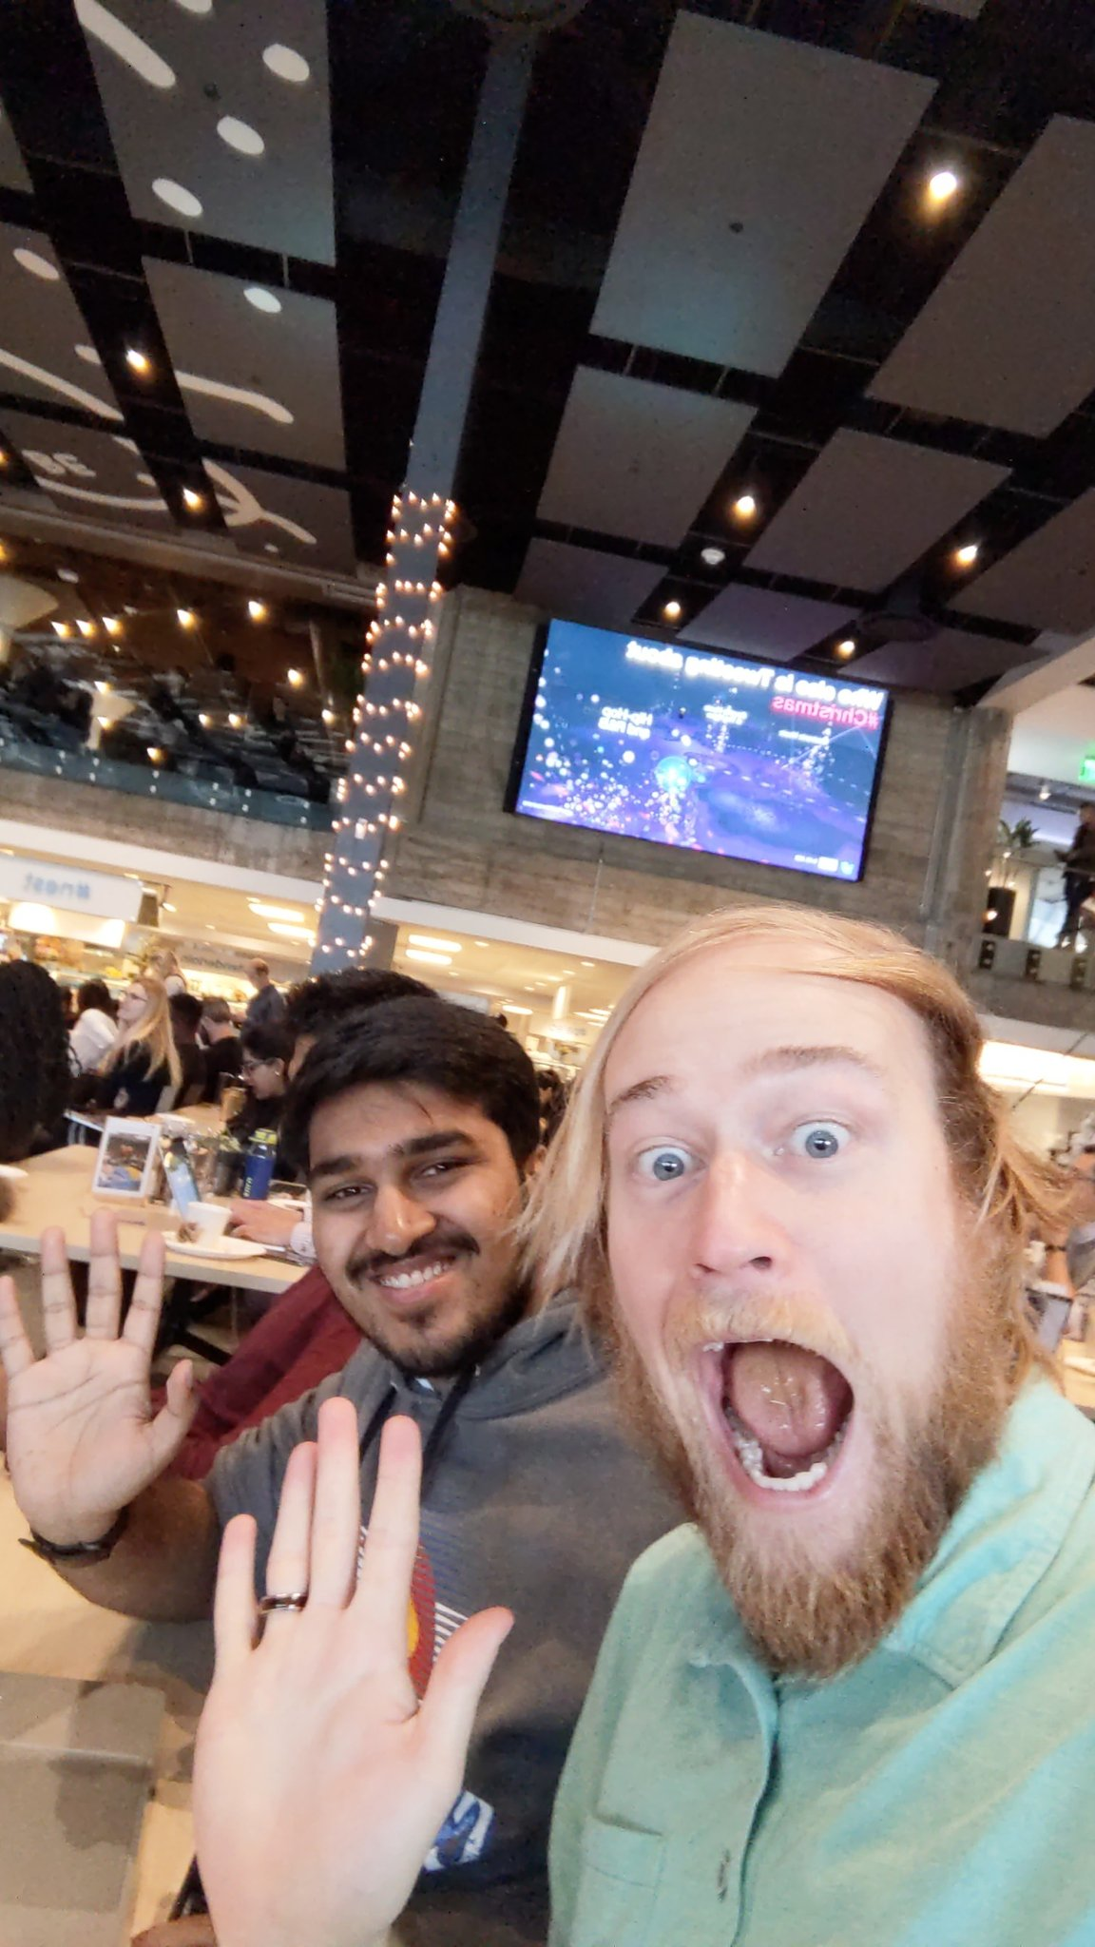
Happy Birthday Brian!!

Slide 3
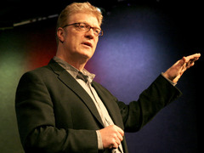
TED talk on creativity
Sir Ken Robinson
http://www.ted.com/talks/ken_robinson_says_schools_kill_creativity.html

Slide 4
Notes:
Starting next week bring your machines to class for quizzes & access to notes.
Start forming teams (Brian to post spreadsheet)
We will get Pivotal & Github set up as teams form.

Slide 5

Creativity
cre·a·tiv·i·ty
ˌkrē-āˈtivitē/
noun
noun: creativity
1.
the use of the imagination or original ideas, esp. in the production of an artistic work.
“Others have seen what is and asked why. I have seen what could be and asked why not. ”
― Pablo Picasso

Slide 6
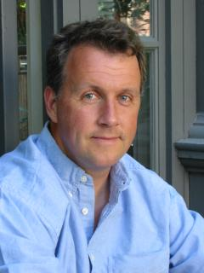
Hackers & Painters
from Hackers & Painters by Paul Graham (http://paulgraham.com/hp.html)
What hackers and painters have in common is that they're both makers. Along with composers, architects, and writers, what hackers and painters are trying to do is make good things. They're not doing research per se, though if in the course of trying to make good things they discover some new technique, so much the better.
I've never liked the term "computer science." The main reason I don't like it is that there's no such thing. Computer science is a grab bag of tenuously related areas thrown together by an accident of history, like Yugoslavia.

Slide 7
Data Sets
Free Public Data Sets on AWS (on EBS or S3) - 55 datasets
http://aws.amazon.com/datasets
NASA NEX
Three NASA NEX datasets are now available, including climate projections and satellite images of Earth.
Ensembl Annotated Human Genome Data (FASTA Release 73)
The Ensembl project produces genome databases for human as well as over 50 other species, and makes this information freely available.
Japan Census Data
Multiple data sets including: (1) Population Census of Japan (1995, 2000, 2005, 2010), (2) Establishment and Enterprise Census of Japan (1999, 2001, 2004, 2006), and (3) Economic Census of Japan (2009).
Sloan Digital Sky Survey DR6 Subset
The Sloan Digital Sky Survey is the most ambitious astronomical survey ever undertaken.
Million Song Dataset
The Million Songs Collection is a collection of 28 datasets containing audio features and metadata for a million contemporary popular music tracks.
Marvel Universe Social Graph
This dataset is an example of a social collaboration network based on the characters in The Marvel Universe, that is, the artificial world that takes place in the universe of the Marvel comic books.

Slide 8
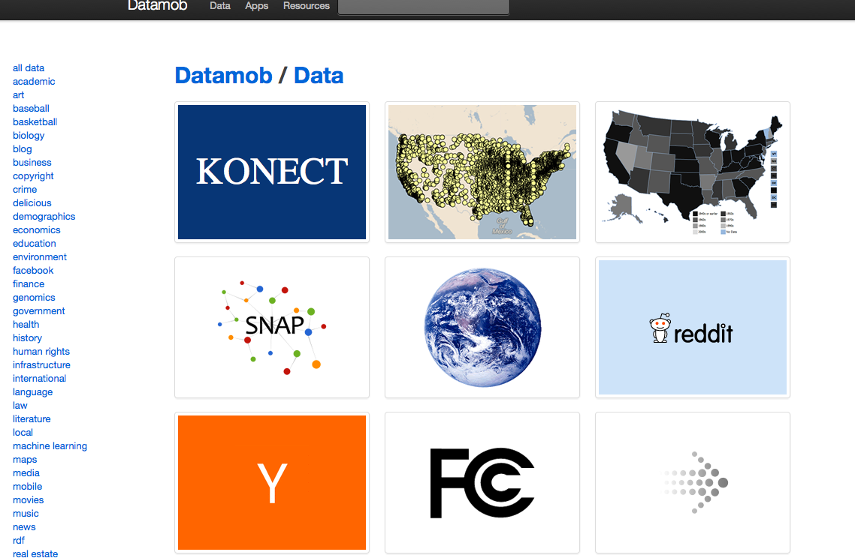
Data Mob
http://datamob.org/datasets

Slide 9
other datasets…..
http://theinfo.org/ http://infochimps.org/datasets http://ckan.org [Comprehensive Knowledge Archive Network] http://www.datawrangling.com/some-datasets-available-on-the-web.html http://del.icio.us/pskomoroch/dataset http://www.reddit.com/r/datasets/ http://news.ycombinator.com/item?id=1242029 http://www.reddit.com/r/opendata http://www.trustlet.org/wiki/Repositories_of_datasets http://www.daniel-lemire.com/blog/data-for-data-mining/ http://www.quantlet.org/mdbase/ http://datamob.org/ http://freebase.com/ http://infochimp.info/ics/data/ripd/www-personal.umich.edu/~mejn/netdata/ http://www.archive-it.org/public/all_collections

Slide 10

Project Ideas
Check out this article:
http://mashable.com/2013/07/17/big-data-projects/
Topology of Tweets
https://blog.twitter.com/2013/the-topography-of-tweets

Slide 11
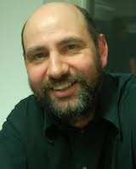
Principles behind the Agile Manifesto
Our highest priority is to satisfy the customer through early and continuous delivery of valuable software.
Welcome changing requirements, even late in development. Agile processes harness change for the customer's competitive advantage.
Deliver working software frequently, from a couple of weeks to a couple of months, with a preference to the shorter timescale.
Business people and developers must work together daily throughout the project.
Build projects around motivated individuals.
Give them the environment and support they need, and trust them to get the job done.
Martin Fowler

Slide 12
continued...
The most efficient and effective method of conveying information to and within a development team is face-to-face conversation.
Working software is the primary measure of progress.
Agile processes promote sustainable development. The sponsors, developers, and users should be able to maintain a constant pace indefinitely.
Continuous attention to technical excellence and good design enhances agility.
Simplicity--the art of maximizing the amount of work not done--is essential.
The best architectures, requirements, and designs emerge from self-organizing teams.
At regular intervals, the team reflects on how to become more effective, then tunes and adjusts its behavior accordingly (retrospectives)

Slide 13
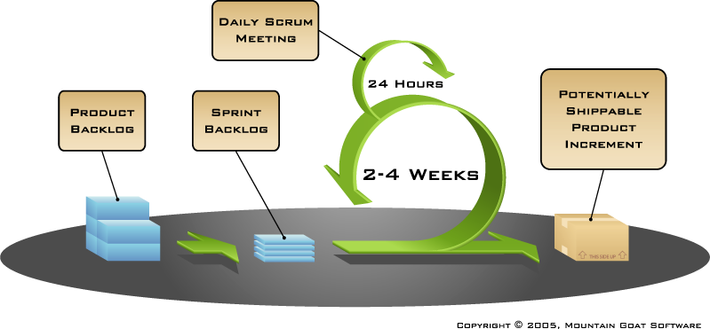
Agile Project Lifecycle

Slide 14
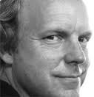
Extreme Programming
Planning User stories are written. Release planning creates the release schedule. Make frequent small releases. The project is divided into iterations. Iteration planning starts each iteration. Managing Give the team a dedicated open work space. Set a sustainable pace. A stand up meeting starts each day. The Project Velocity is measured. Move people around. Fix XP when it breaks. Designing Simplicity. Choose a system metaphor. Use CRC cards for design sessions. Create spike solutions to reduce risk. No functionality is added early. Refactor whenever and wherever possible. | Coding The customer is always available. Code must be written to agreed standards. Code the unit test first. All production code is pair programmed. Only one pair integrates code at a time. Integrate often. Set up a dedicated integration computer. Use collective ownership. Testing All code must have unit tests. All code must pass all unit tests before it can be released. When a bug is found tests are created. Acceptance tests are run often and the score is published.
Kent Beck

Slide 15
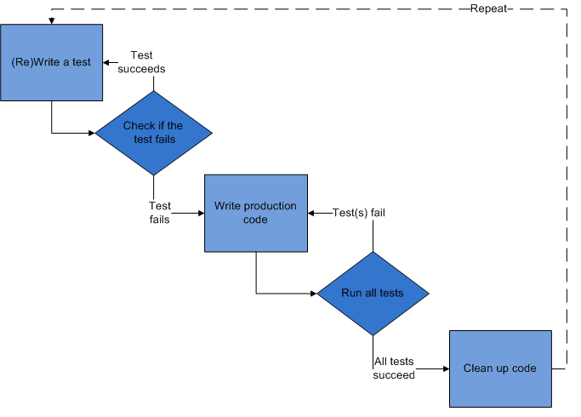
Test Driven Development

Slide 16
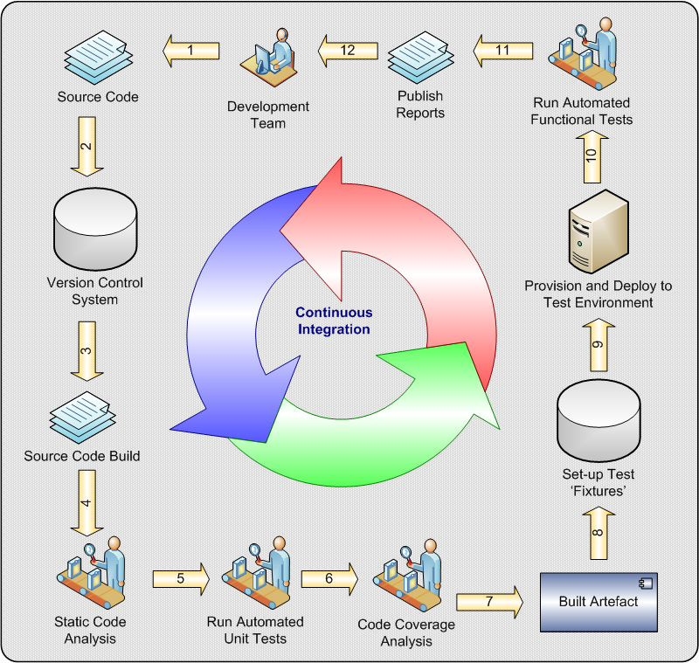
Continuous Integration

Slide 17
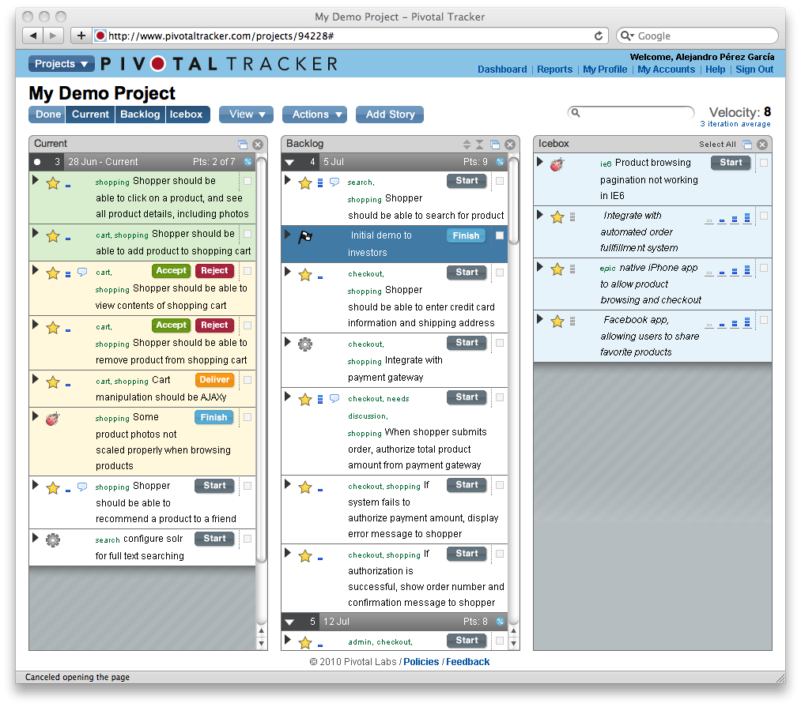
Pivotal Tracker
https://www.pivotaltracker.com

Slide 18
Resources
Agile (Martin Fowler)
http://martinfowler.com/articles/newMethodology.html
Lecture: https://www.youtube.com/watch?v=GE6lbPLEAzc
Extreme Programming (Kent Beck)
http://c2.com/cgi/wiki?ExtremeProgramming
http://www.amazon.com/Extreme-Programming-Explained-Embrace-Edition/dp/0321278658
Test Driven Development
http://c2.com/cgi/wiki?TestDrivenDevelopment
Continuous Integration
http://martinfowler.com/articles/continuousIntegration.html
http://jenkins-ci.org/
http://cruisecontrol.sourceforge.net/

Slide 19
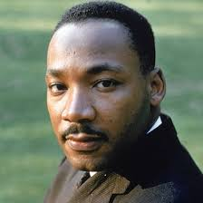
MLK
https://www.youtube.com/watch?v=aL4FOvIf7G8

